Slide 1
LightSail v3 Badge Library
September 2015
LightSail Education

Slide 2
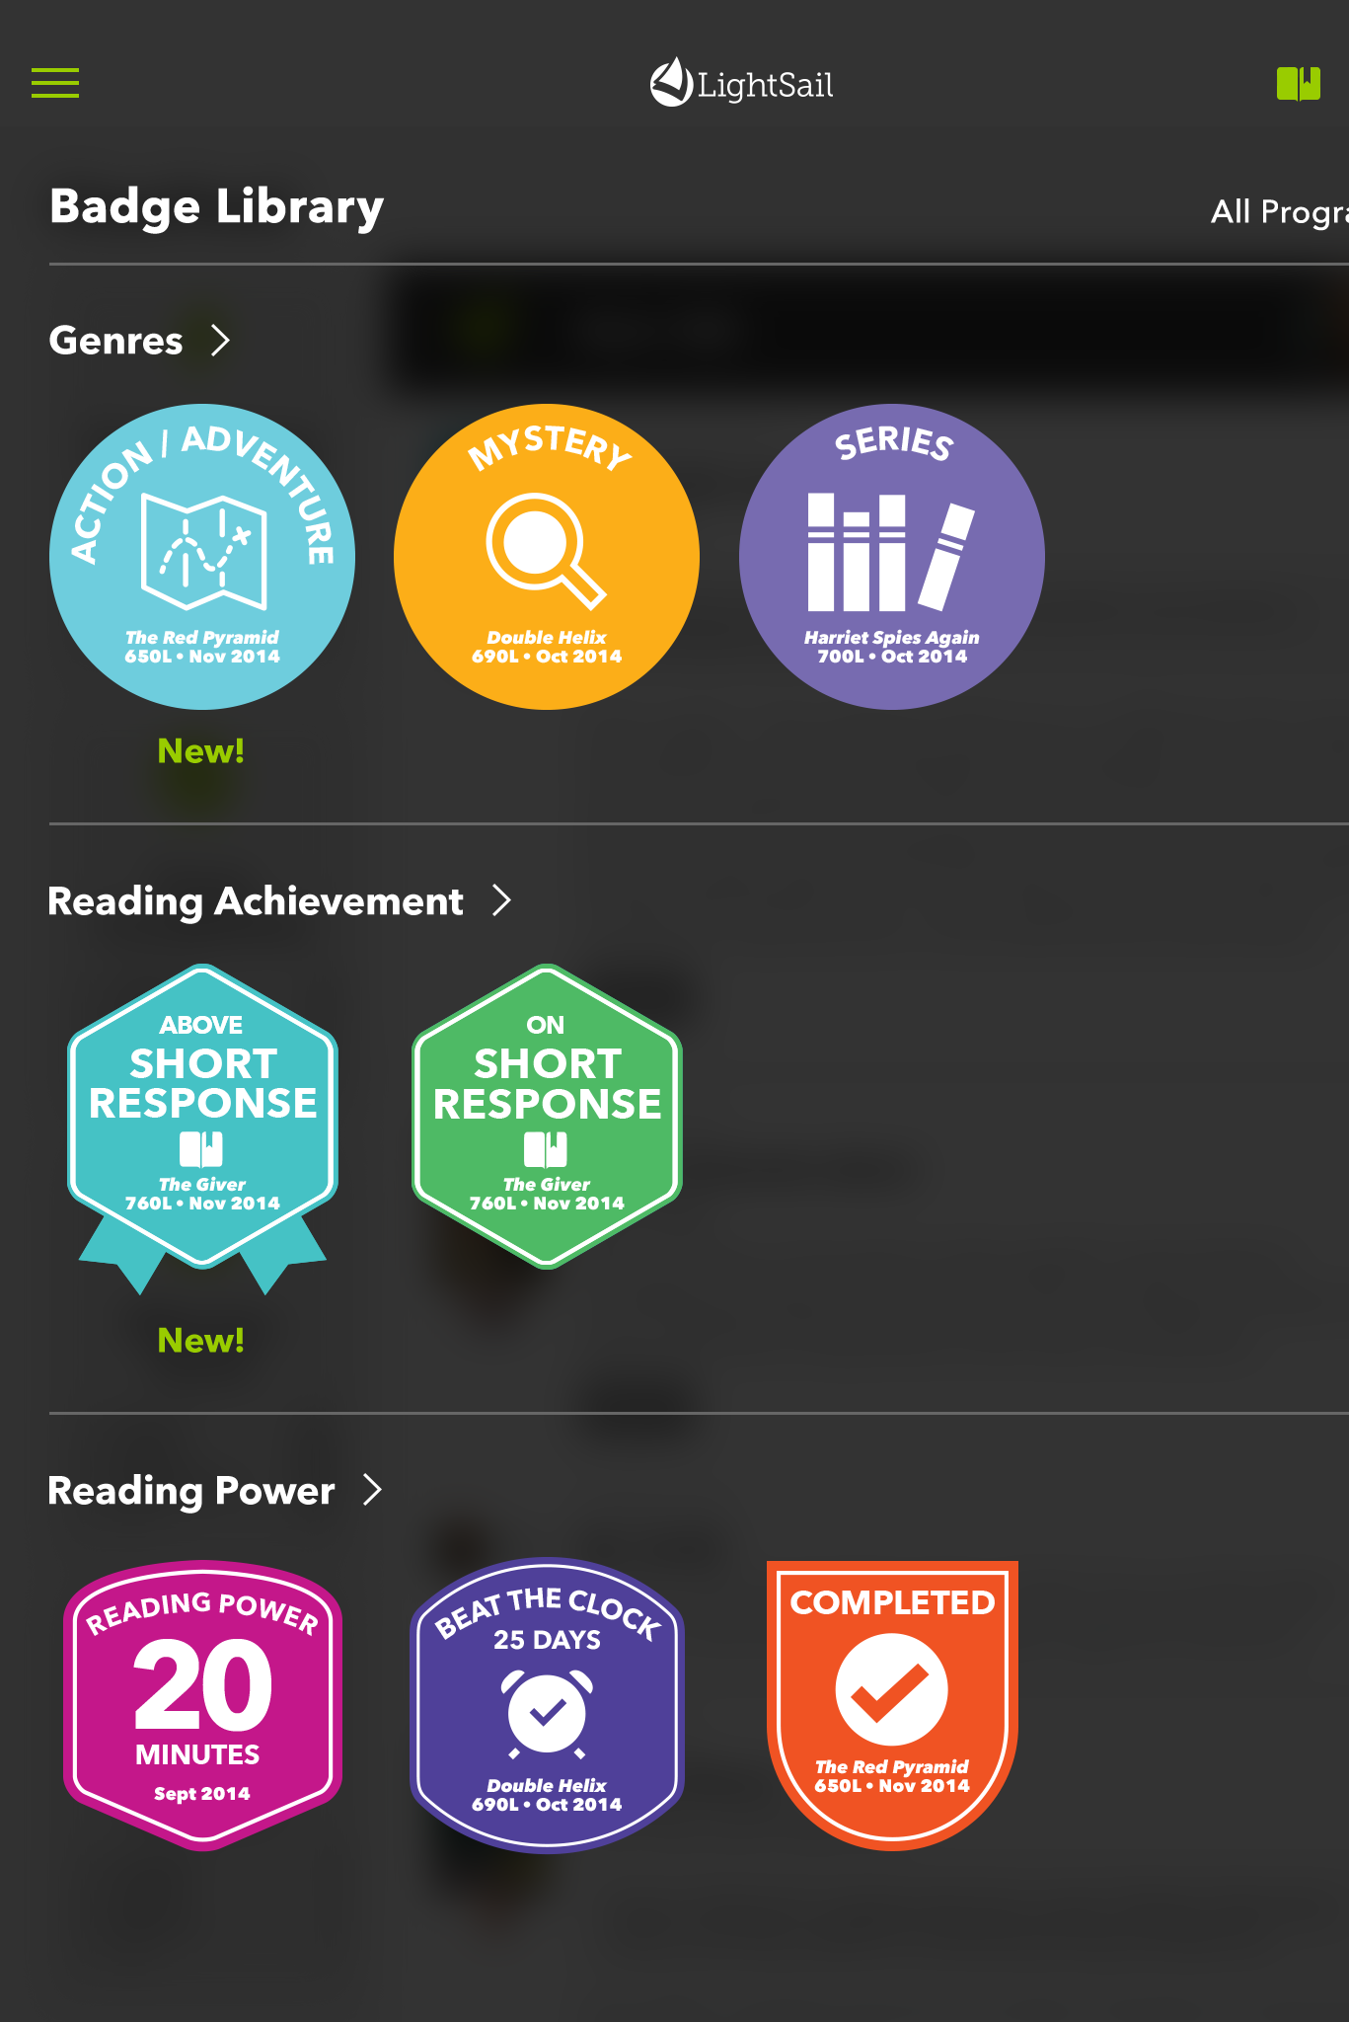
Encourage your students to be superstars.
Students earn badges for
Genres, Reading Achievement,
and Reading Power in the
LightSail Badge Library.

Slide 3
Customize these badges to display in your room.
Using Avenir Next as your font, you can customize the book and date of each badge.

Slide 4

Action/Adventure Badge
Book Title
000L • Sep 2015

Slide 5

All About Badge
Book Title
000L • Sep 2015

Slide 6

Anthologies Badge
Book Title
000L • Sep 2015

Slide 7

Autobiography Badge
Book Title
000L • Sep 2015

Slide 8

Biography Badge
Book Title
000L • Sep 2015

Slide 9

Classics Badge
Book Title
000L • Sep 2015

Slide 10

Drama Badge
Book Title
000L • Sep 2015

Slide 11

Essays Badge
Book Title
000L • Sep 2015

Slide 12

Fairytales Badge
Book Title
000L • Sep 2015

Slide 13

Fantasy Badge
Book Title
000L • Sep 2015

Slide 14

Folktales/Fables Badge
Book Title
000L • Sep 2015

Slide 15

Geography Badge
Book Title
000L • Sep 2015

Slide 16

Graphic Novels Badge
Book Title
000L • Sep 2015

Slide 17

Historical Fiction Badge
Book Title
000L • Sep 2015

Slide 18

History Badge
Book Title
000L • Sep 2015

Slide 19

Humor Badge
Book Title
000L • Sep 2015

Slide 20

Legends/Myths Badge
Book Title
000L • Sep 2015

Slide 21

Mathematics Badge
Book Title
000L • Sep 2015

Slide 22

Mystery Badge
Book Title
000L • Sep 2015

Slide 23

Picture Books Badge
Book Title
000L • Sep 2015

Slide 24

Poetry Badge
Book Title
000L • Sep 2015

Slide 25

Realistic Fiction Badge
Book Title
000L • Sep 2015

Slide 26

Romance Badge
Book Title
000L • Sep 2015

Slide 27

Science Badge
Book Title
000L • Sep 2015

Slide 28

Science Fiction Badge
Book Title
000L • Sep 2015

Slide 29

Self Help Badge
Book Title
000L • Sep 2015

Slide 30

Series Badge
Book Title
000L • Sep 2015

Slide 31

Short Stories Badge
Book Title
000L • Sep 2015

Slide 32

Spanish Badge
Book Title
000L • Sep 2015

Slide 33

Speeches Badge
Book Title
000L • Sep 2015

Slide 34

Thriller/Suspense Badge
Book Title
000L • Sep 2015

Slide 35

Completed Badge
Book Title
000L • Sep 2015

Slide 36

Milestone Badge
00
Sep 2015

Slide 37

Reading Power Badge
00
Sep 2015

Slide 38

Power Texts Badge
0

Slide 39

Beat the Clock Badge
00 Days
Book Title
000L • Sep 2015

Slide 40

Million Words Read Badge
0
Sep 2015

Slide 41

Vocabulary Clozes Badge
000
Sep 2015

Slide 42

Vocabulary Genius Badge
Sep 2015

Slide 43

On Short Response Badge
Book Title
000L • Sep 2015

Slide 44

Above Short Response Badge
Book Title
000L • Sep 2015

