Slide 1
Note to Teacher
This slideshow should be taught in two parts:
  Part 1 (slides 2-32): During In-School Kick Off
  Part 2 (slides 33-66): During Instructional Half-Day Session #1

Slide 2


SummerSail 2016
Student Kick-Off!
Notes:
Thank you so much for making the time to come here today.

Slide 3
Logging In and Choosing Books
Student Kick-Off Part 1

Slide 4
Welcome to
SummerSail 2016!

Slide 5
What is SummerSail?
SummerSail is a summer reading program where you get to choose what books you read.
SummerSail is about reading for FUN all summer long!
You’ll record your thoughts and ask questions, and I will be able to respond back to you!
You’ll read on iPads or Chromebooks.

Slide 6
Where will you read?
We’ll meet four times over the summer, but other than that, you’ll read at home.
You’ll use LightSail on your device.
If you need a device to read on, our school will lend you one.

Slide 7
How long is SummerSail?
SummerSail starts today and ends the first week of next school year.

Slide 8
How did you get picked?
We chose you to be part of SummerSail because we think you are responsible!
We know you will work hard to improve your reading skills over the summer.

Slide 9
What is your job?
Read any book of your choosing on your device at least four hours a week.
Make at least four high-quality annotations each week.
Come to the four in-school sessions.
Come to the mid-summer reading celebration!

Slide 10
When are we meeting?
Week of July 7 In-School Session #1
Week of July 11 In-School Session #2
Week of July 18 In-School Session #3
Tuesday, July 26 Mid-Summer Reading Celebration
Week of August 1 In-School Session #4
Sessions start at 8am and end at noon.
Make sure to bring your iPad or Chromebook!

Slide 11
Where are we meeting?
We’ll meet at school. Look for signs to know which classroom.
For the mid-summer celebration, we’ll meet at school and travel together to meet up with all the other schools participating in SummerSail.

Slide 12
What are we doing today?
Distributing devices.
Logging in.
Checking out books.
Getting excited!

Slide 13
How to Log In

Slide 14
Logins
You’ll get a new username and temporary password.
Even if you used LightSail before, you’ll have a different username during the summer.
I’ll pass out usernames and temporary passwords now!

Slide 15
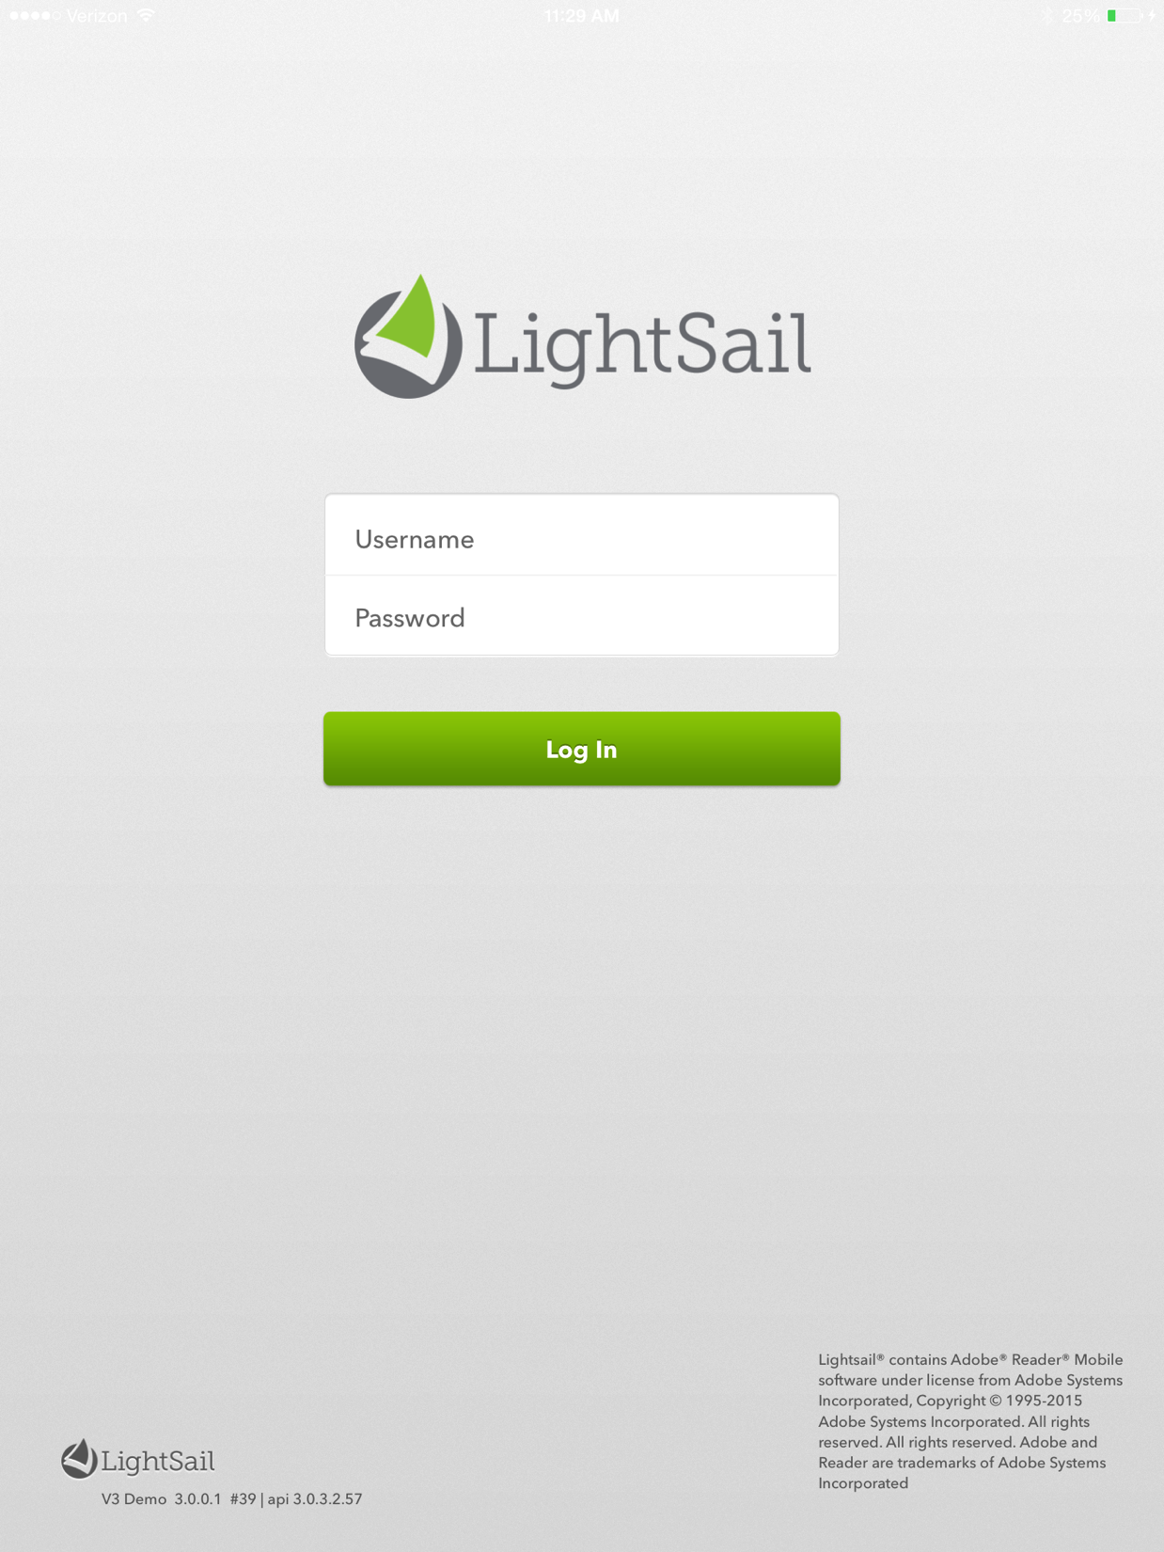

Log In for the First Time
Step 1: Type your username.

Slide 16
Log In for the First Time
Step 1: Type your username.
Step 2: Type your temporary password.

Slide 17
Log In for the First Time
Step 1: Type your username.
Step 2: Type your temporary password.
Step 3: Tap Log In.

Slide 18
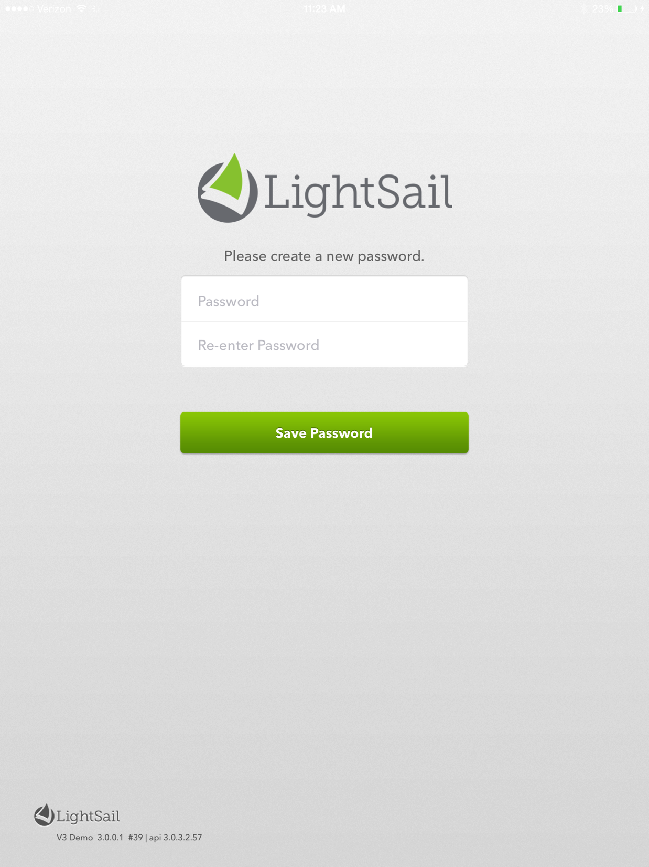
Log In for the First Time
Step 1: Pick your own password and type it in where it says Password.

Slide 19
Log In for the First Time
Step 1: Pick your own password and type it in where it says Password.
Step 2: Type your password again where it says Re-enter Password.
Keep this password a secret!

Slide 20
Log In for the First Time
Step 1: Pick your own password and type it in where it says Password.
Step 2: Type your password again where it says Re-enter Password.
Step 3: Tap Save Password.

Slide 21
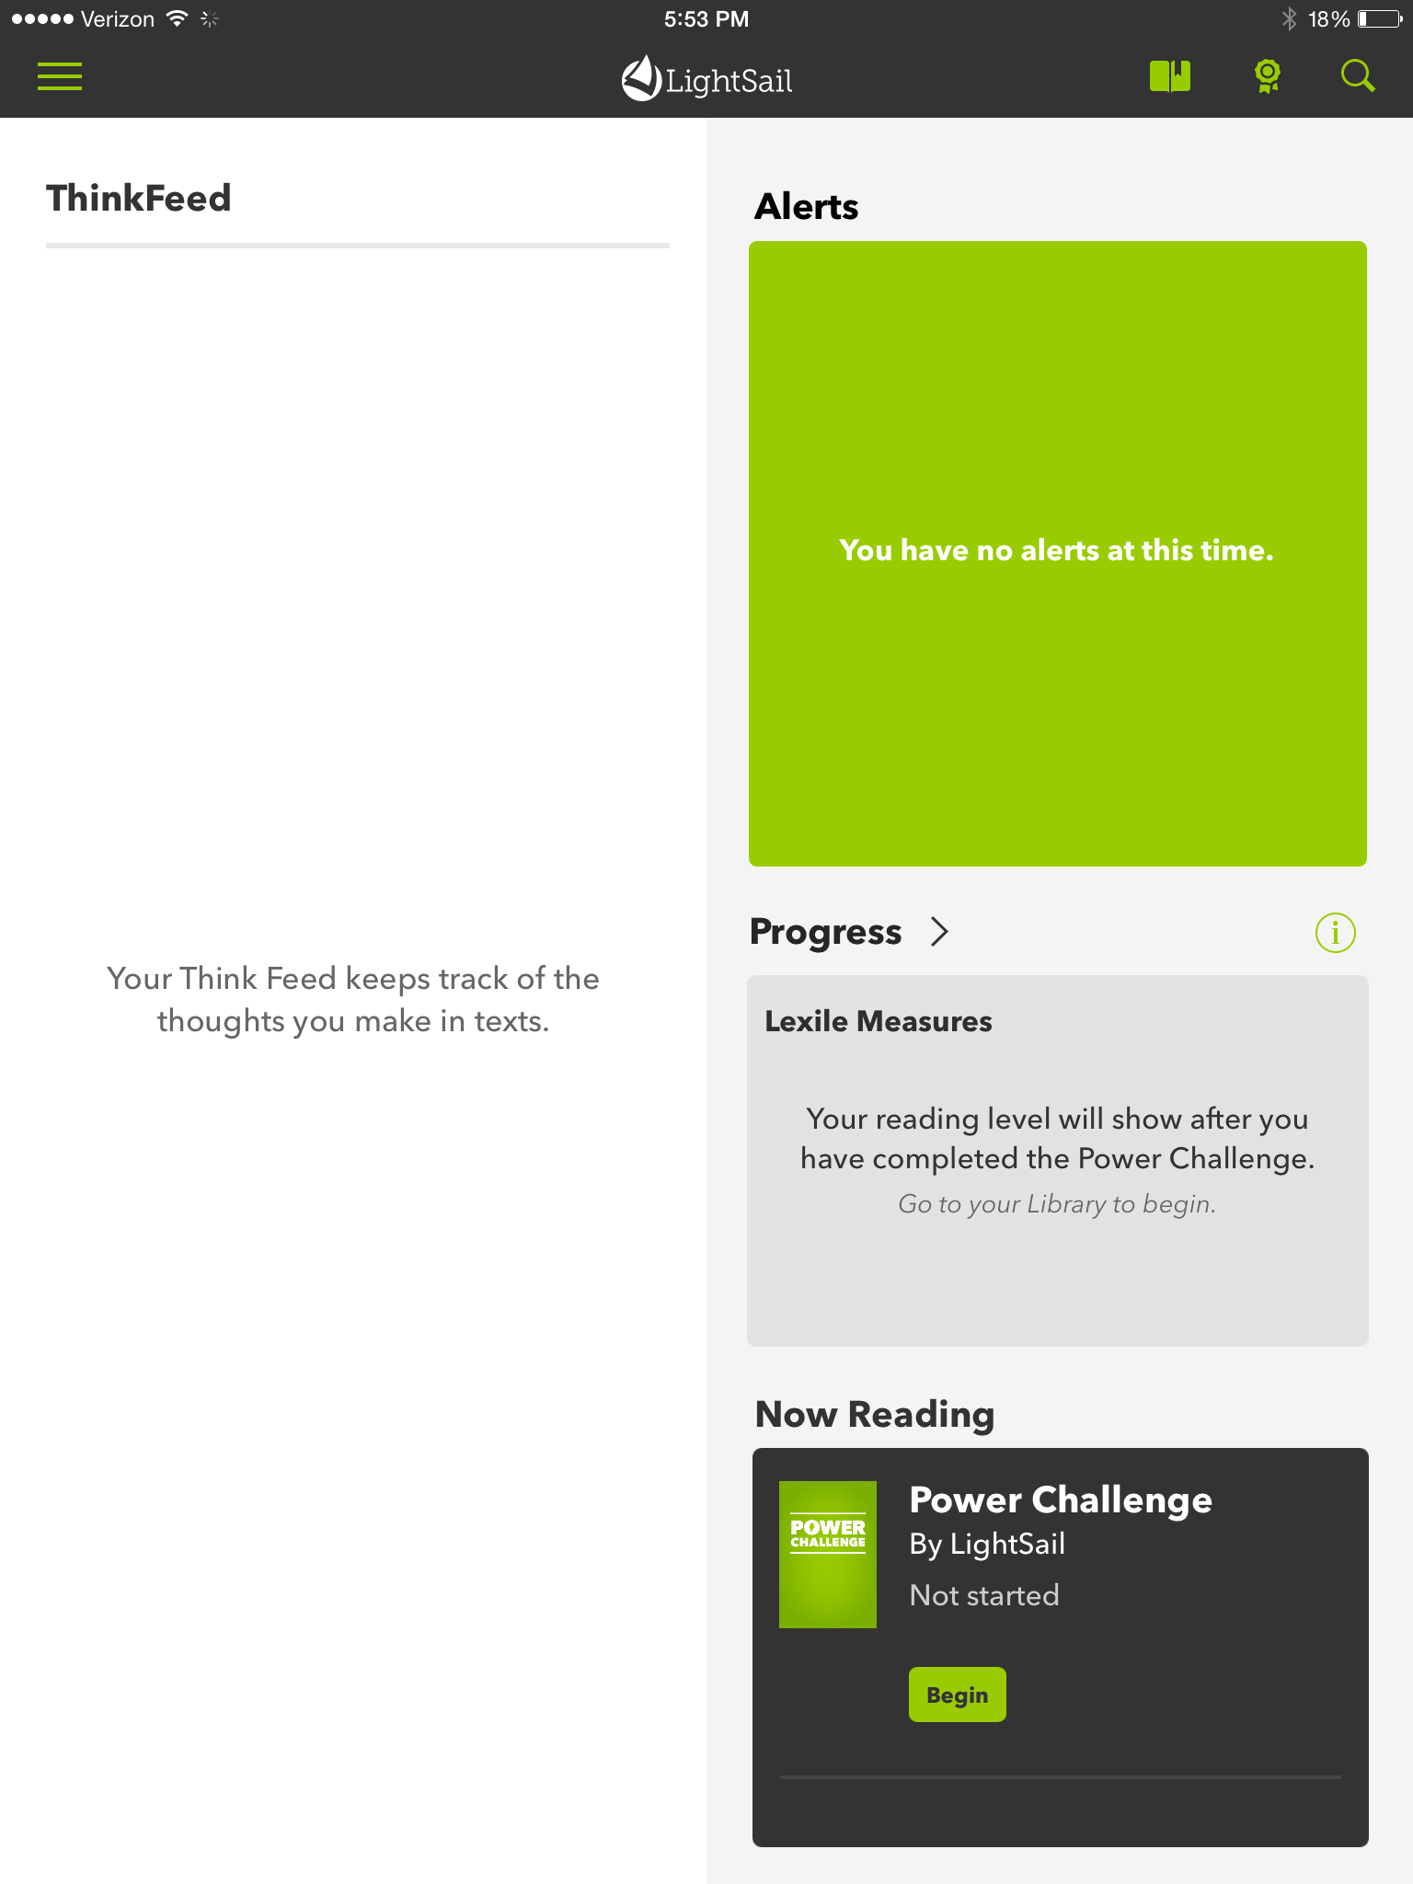
Dashboard
This is what your screen will look like once you have logged in.
Student

Slide 22
How to Find a Book

Slide 23
Library
Look for books with the lightning bolt icon to start. (Hint: You’ll find them on your Power Texts Shelf!)
Later, you can search the Library by Genre or Topic.

Slide 24
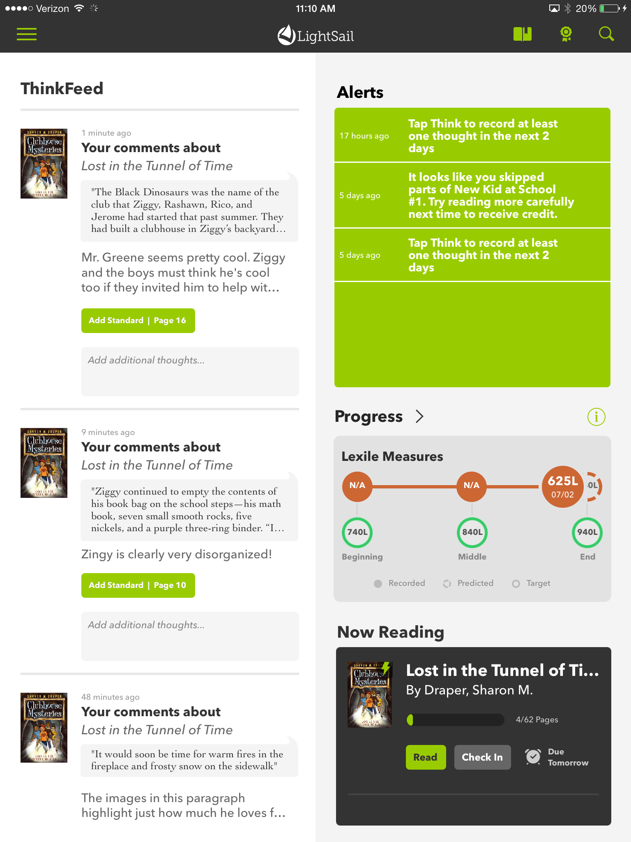
Access the Library
Tap the three lines to see the menu and move to different parts of the app.

Slide 25
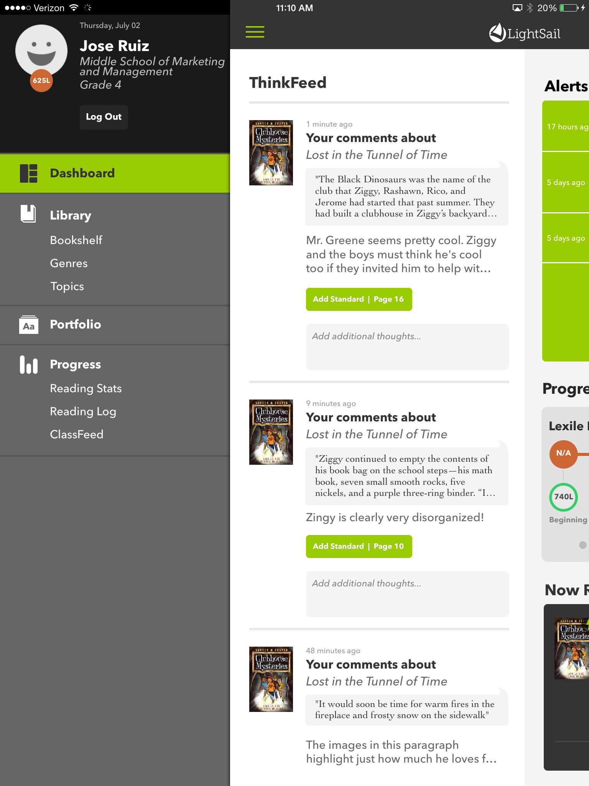
Access the Library
Tap Library.
Later, you can tap Genres or Topics to look for books in other ways.

Slide 26
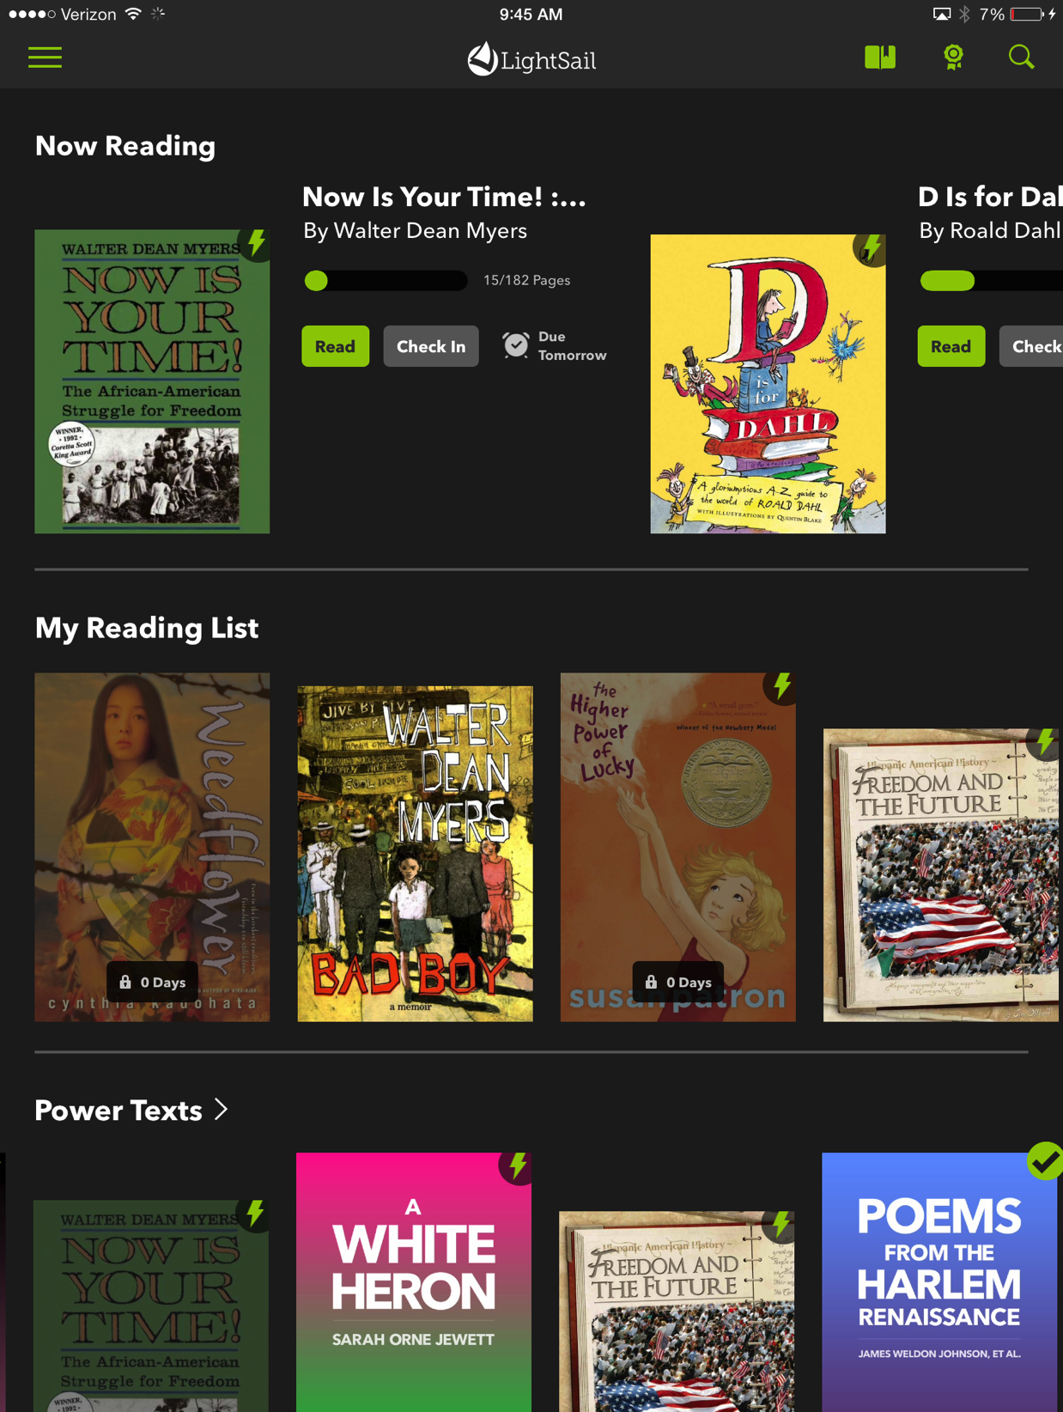
Library Notes
You’ll pick your first book from the Power Texts Shelf.
Power Texts are “just right” books.
Look for the to find Power Texts.

Slide 27
Library Notes
Books you have checked out show up on top.
You can check out up to 2 books.

Slide 28
Library Notes
Tap Read to open a book.
Tap Check In to return it so another student can read it.

Slide 29
Library Notes
You can add books you want to read later to your Reading List.

Slide 30
Library Notes
Dark books are currently unavailable.

Slide 31

Open a Book
Tap on a book.
Then tap Read!

Slide 32
In your own words, how do you check out a book from the LightSail Library?
?

Slide 33
Taking Assessments and Making Thoughts
Student Kick-Off Part 2

Slide 34
How to Grow Your Lexile

Slide 35
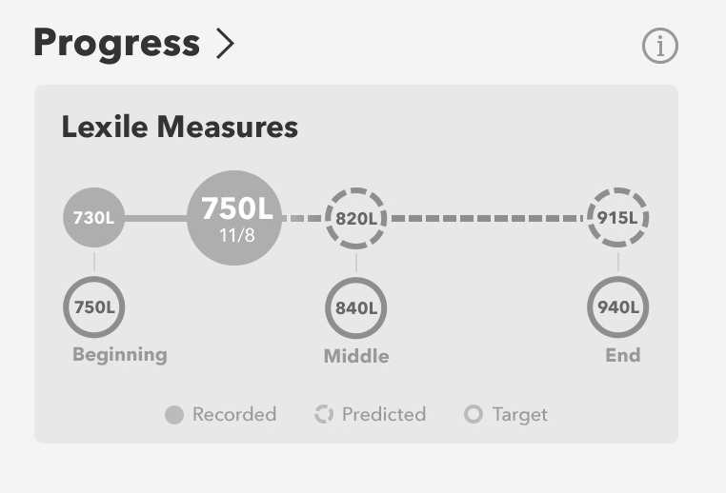
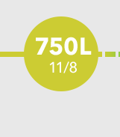
What is a Lexile?
A Lexile is a number that describes your current reading comprehension. It grows as you become a stronger reader.

Slide 36
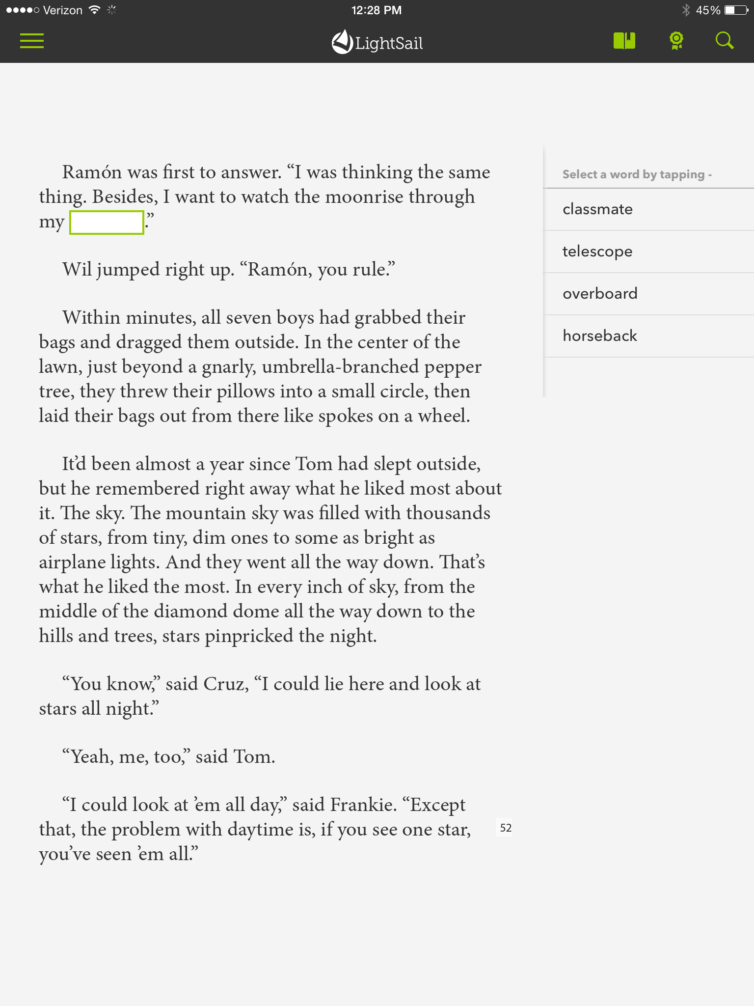
How is your Lexile measured?
LightSail uses your performance on cloze assessments to update your Lexile measure.

Slide 37
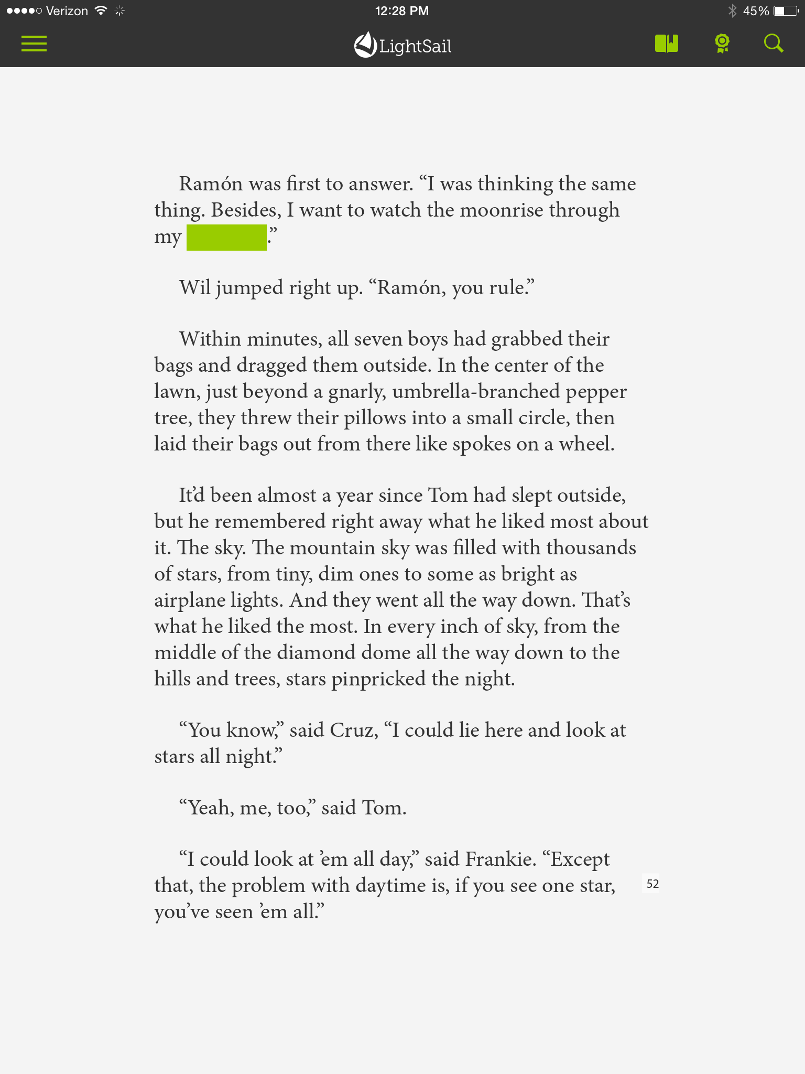
Cloze
Tap the green box.

Slide 38
Cloze
Tap the green box.
Then tap the word you think fits in the blank.

Slide 39
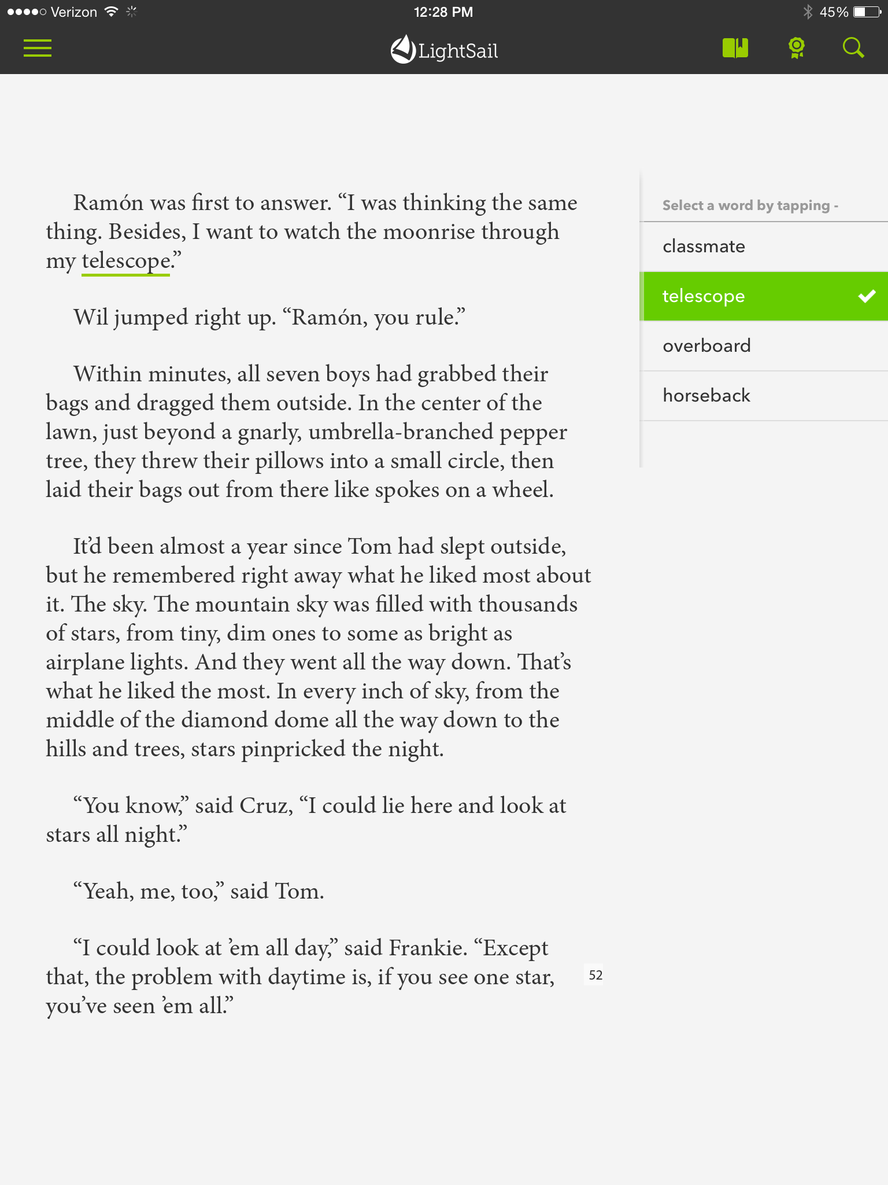
Cloze
Tap the green box.
Then tap the word you think fits in the blank.

Slide 40
Cloze Strategies
“Hey, Mouse,” she said. They’d called him that since he was a baby; she couldn’t exactly remember why. He reminded her of a big, puppy – always excited, always trying to jump on your lap.
Text from Eleanor and Park by Rainbow Rowell
Notes:
Cloze!

Slide 41
Cloze Strategies
“Hey, Mouse,” she said. They’d called him that since he was a baby; she couldn’t exactly remember why. He reminded her of a big, puppy – always excited, always trying to jump on your lap.
Text from Eleanor and Park by Rainbow Rowell
What word do you predict might fit?
Notes:
Cloze!

Slide 42
Cloze Strategies
“Hey, Mouse,” she said. They’d called him that since he was a baby; she couldn’t exactly remember why. He reminded her of a big, puppy – always excited, always trying to jump on your lap.
Text from Eleanor and Park by Rainbow Rowell
What strategies could you use other than prediction?
Notes:
Cloze!

Slide 43
Cloze Strategies
“Hey, Mouse,” she said. They’d called him that since he was a baby; she couldn’t exactly remember why. He reminded her of a big, puppy – always excited, always trying to jump on your lap.
Select a word by tapping –
native
frizzy
unhurt
sloppy
Once you’ve seen the answer choices, what other strategies could you use?
Text from Eleanor and Park by Rainbow Rowell
Notes:
Cloze options

Slide 44

Cloze Strategies
“Hey, Mouse,” she said. They’d called him that since he was a baby; she couldn’t exactly remember why. He reminded her of a big, puppy – always excited, always trying to jump on your lap.
Select a word by tapping –
native
frizzy
unhurt
sloppy
Text from Eleanor and Park by Rainbow Rowell
Notes:
Cloze, answered (incorrect+correct)

Slide 45
Cloze Strategy: Predict
Before you tap on the green box, see if you can determine what word could fit in that blank. Then look for a similar word amongst the answer choices!

Slide 46
Cloze Strategy: Substitute
Read the sentence over, substituting each answer choice for the missing word, to see which sounds the best!

Slide 47
Cloze Strategy: Reread
Reread at least 2-3 sentences that come before the sentence containing the green box! You might find helpful context clues!

Slide 48
Cloze Strategy: Read On
Read at least 2-3 sentences after the sentence containing the green box. You might find helpful context clues!

Slide 49
Cloze Strategy: Eliminate
Identify which words you know don’t fit into the blank, then make an educated guess from the remaining choices.

Slide 50
Cloze Strategy: Context Clues
Think about what is happening in the book at that moment.

Slide 51
Cloze Strategies
Predict: Before you tap on the green box, see if you can determine what word could fit in that blank. Then look for a similar word amongst the answer choices!
Substitute: Read the sentence over, substituting each answer choice for the box, to see which sounds the best!
Reread: Reread at least 2-3 sentences that come before the sentence containing the green box! You might find helpful context clues!
Read On: Read at least 2-3 sentences after the sentence containing the green box. You might find helpful context clues!
Use Process of Elimination: Identify which words you know don’t fit into the box, then make an educated guess from the remaining choices.
Look for Context Clues: Think about what is happening in the book at that moment.

Slide 52
In your own words, what should you do when you are reading a book and you see a small green box?
?

Slide 53
How to Make a Thought

Slide 54
Why might you want to write something in your book?
Practice a strategy
Communicate with a teacher
Make your thinking visible
Respond to a prompt
Write down a question

Slide 55
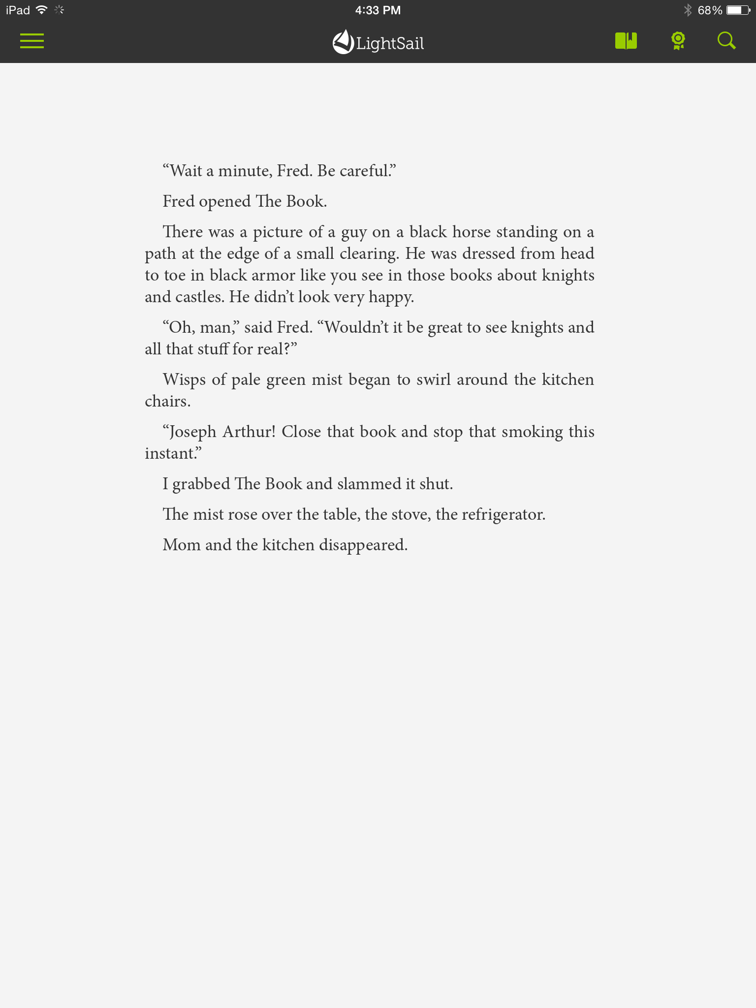
Make a Thought
1. Tap and hold on a word until you see a circle.
2. Use the blue lines to expand your highlight.
3. Tap Add Thought.
4. Type your thought.
5. Tap Save Thought.

Slide 56
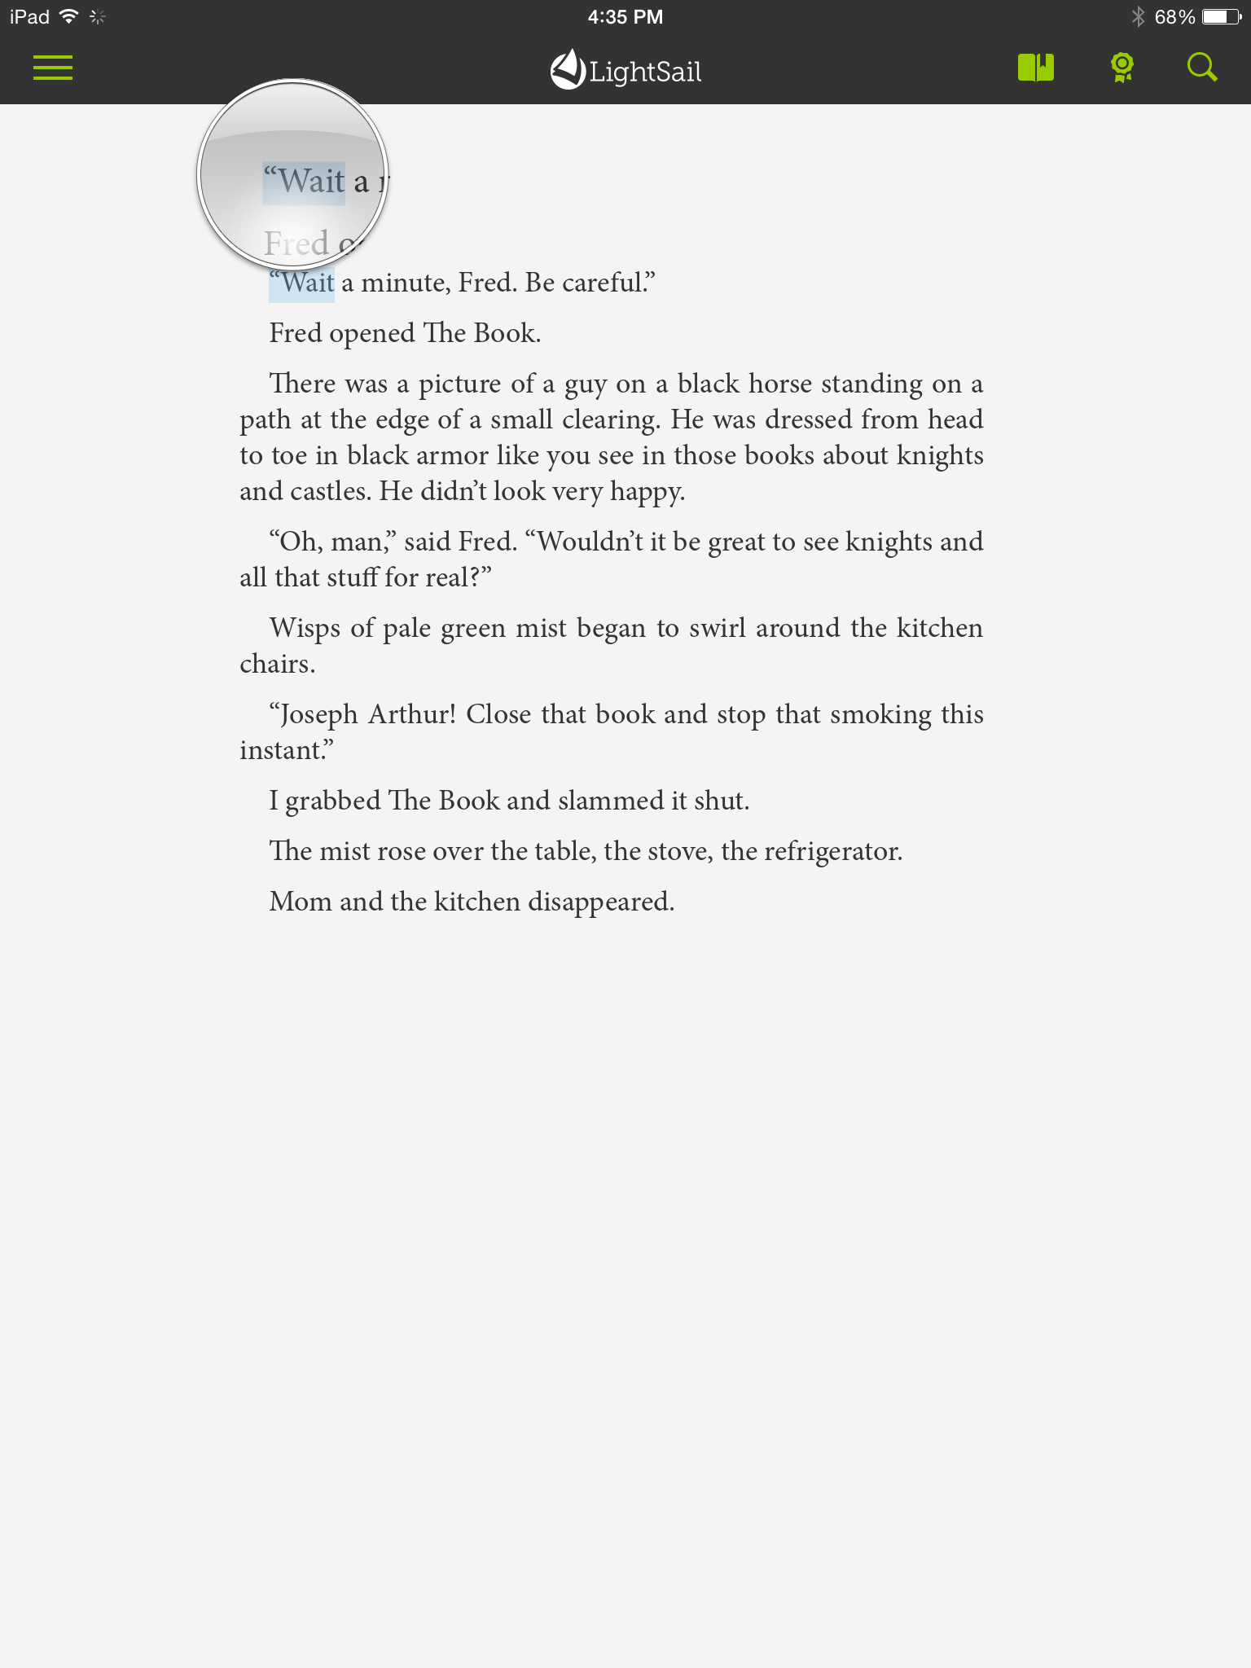
Make a Thought
1. Tap and hold on a word until you see a circle.
2. Use the blue lines to expand your highlight.
3. Tap Add Thought.
4. Type your thought.
5. Tap Save Thought.

Slide 57
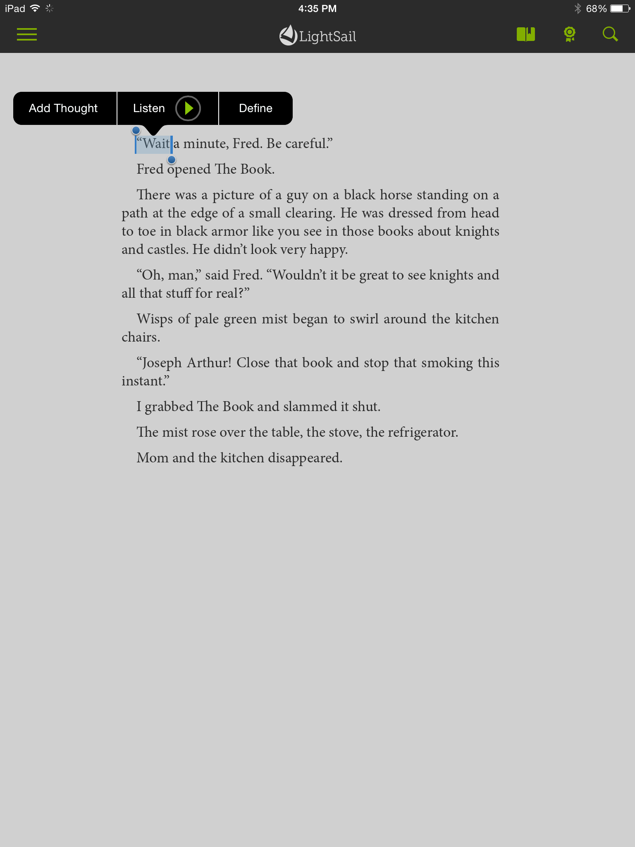
Make a Thought
1. Tap and hold on a word until you see a circle.
2. Use the blue lines to expand your highlight.
3. Tap Add Thought.
4. Type your thought.
5. Tap Save Thought.

Slide 58
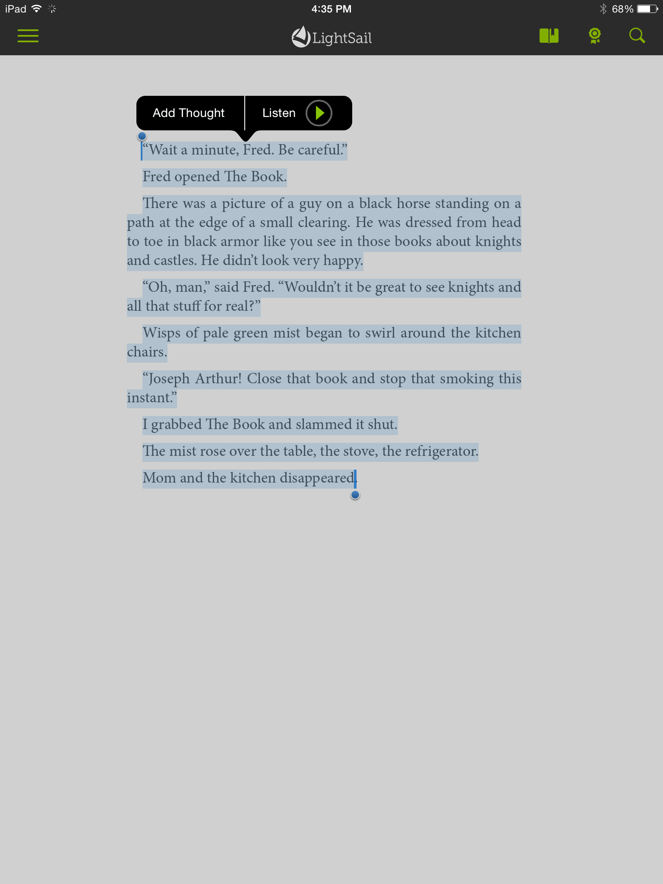
Make a Thought
1. Tap and hold on a word until you see a circle.
2. Use the blue lines to expand your highlight.
3. Tap Add Thought.
4. Type your thought.
5. Tap Save Thought.

Slide 59
Make a Thought
1. Tap and hold on a word until you see a circle.
2. Use the blue lines to expand your highlight.
3. Tap Add Thought.
4. Type your thought.
5. Tap Save Thought.

Slide 60
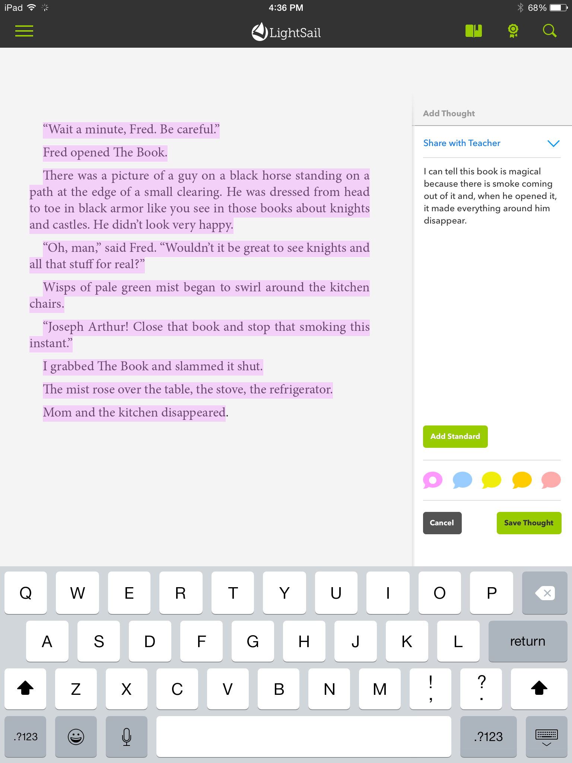
Make a Thought
1. Tap and hold on a word until you see a circle.
2. Use the blue lines to expand your highlight.
3. Tap Add Thought.
4. Type your thought.
5. Tap Save Thought.

Slide 61
Make a Thought
1. Tap and hold on a word until you see a circle.
2. Use the blue lines to expand your highlight.
3. Tap Add Thought.
4. Type your thought.
5. Tap Save Thought.

Slide 62
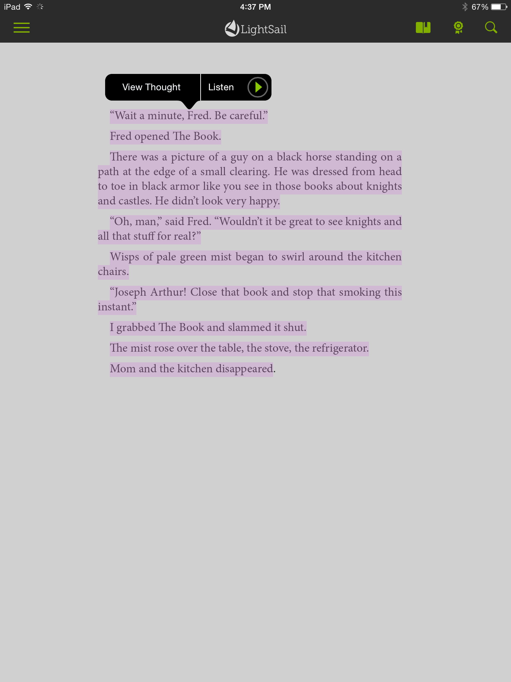
See Your Past Thought
Tap the highlight.
Then tap View Thought.

Slide 63
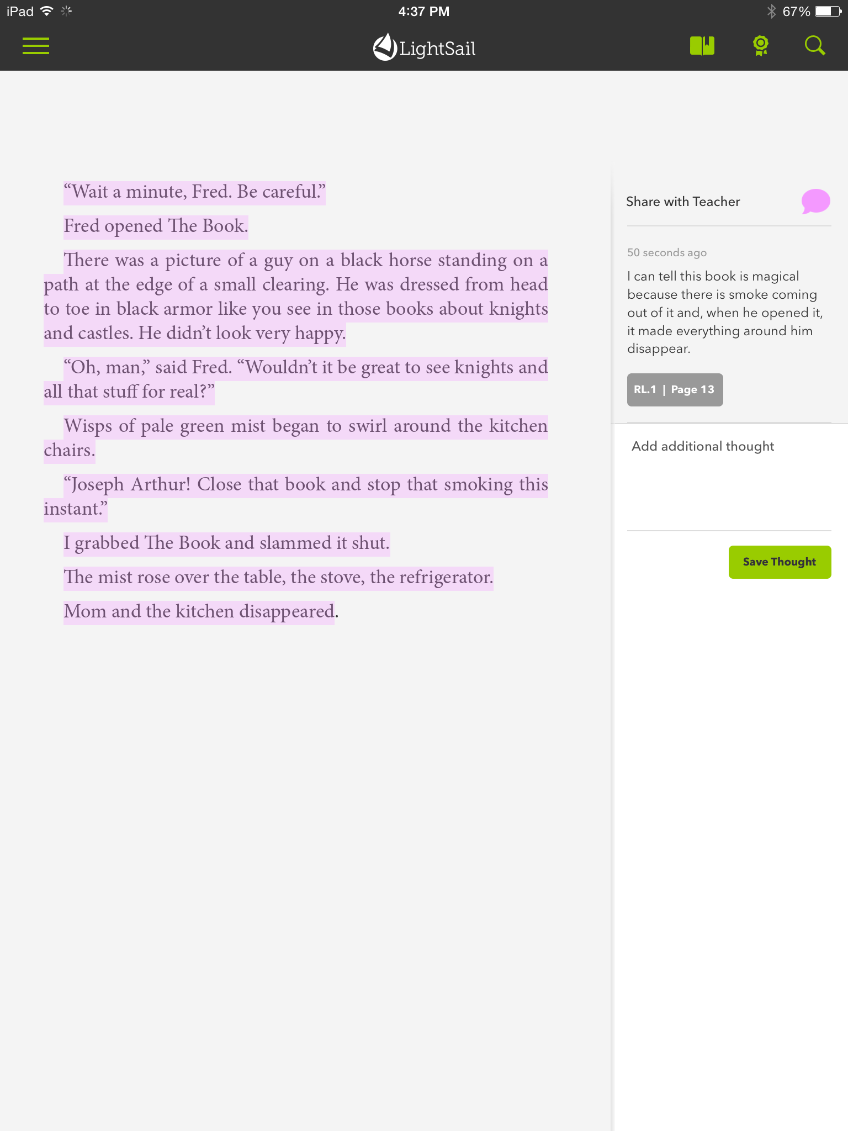
See Your Past Thought
Tap the highlight.
Then tap View Thought.

Slide 64
See Your Past Thought
You’ll also see your thought and the text you highlighted on your Dashboard in the ThinkFeed.

Slide 65
See Your Past Thought
If I respond, you’ll see it here.
Tap here to respond to my response.

Slide 66
Happy Summer Reading!

